Slide 1

PROJECT REPORT
ON
LIBRARY MANAGEMENT SYSTEM
By:-
AMIT JAISWAL (13CS01004)
SHANKAR KUMAR CHAUDHARY (13CS01016)
Computer Science & Engineering

Slide 2
Content
1. Introduction
2. Motivation and Objective
3. Features of Members in Database
3. Features of Librarian in Database
4. Constraint and Flexibility
5. Design and Implementation
5.1 Relational Schema (normalized)
5.2 E-R Diagram.
5.2 Tables, Methods and SQL Queries
6. Experimental Results and Discussion
6.1 Experimental Set Up (back end platform + GUI)
6.2 some screen shots
6.2 Future Works

Slide 3
Introduction
This project aims in developing a computerized system to maintain library Database .
Library Management System is a tool developed that helps librarians and students to access the information in an organized way.
This tool has two interfaces. One is librarian-side (admin) interface and other is member-side interface.
Each side interface can be accessed only after logging in with correct ID and password.
We have also incorporated online notification (email) feature. After updation of information or after issue or return of books an email will be sent to corresponding member.
We have also incorporated automatic fine calculation feature.
Overall this project of ours is being developed to help the students as well as staff of library to maintain the library in the best way possible and also reduce the human efforts.

Slide 4
Motivation and Objective.
This provides a basic platform to Manage Library Database.
The various database tables used are implemented keeping in mind all the possible situations to be encountered
Our motivation is to know the implementation of the real life database system and their working.
To learn implementation of GUI.

Slide 5
Features of Member in Data Base
Each Member is having an account with his personal details.
Member after logging in can :-
search books according to:-
Author Name
Book title
publisher name
issue/return book and also
can update its information.

Slide 6
Features of Librarian in Data Base
Each Librarian is having an account with his personal details.
Librarian after logging in can :-
can update its information.
View/update member’s information,
view/update/insert book information,
Add new category to books
can view borrowed transactions and fined transactions.
Can search student transaction detail by id and name

Slide 7
Constraints and Flexibility
Constraint
Student can Avail limited number of books.
membership consideration:-
student(btech ,mtech,msc,phd)
prof
Flexibility
If Librarian added a book with new category which is not available in database the new category with category_id is generated automatically that is there is no constraint on category of books a variety of books can be addressed in this library database system.

Slide 8
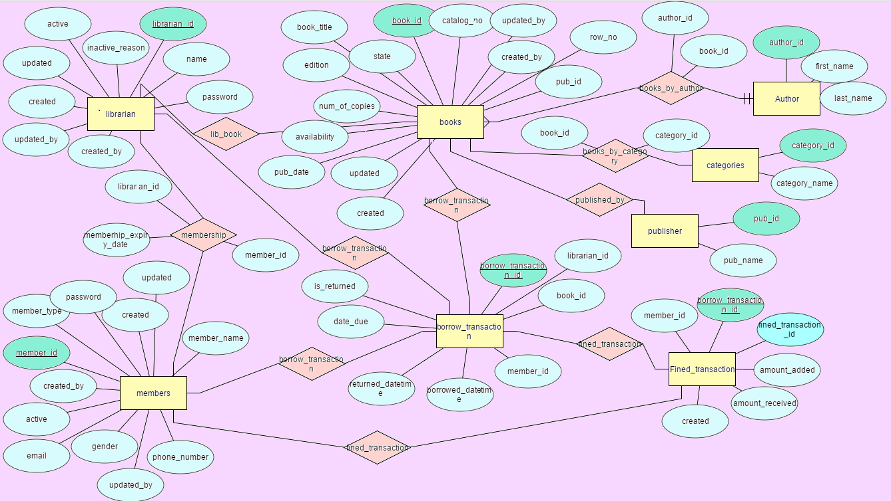
Design and Implementation
Entity-Relation Diagrams.

Slide 9
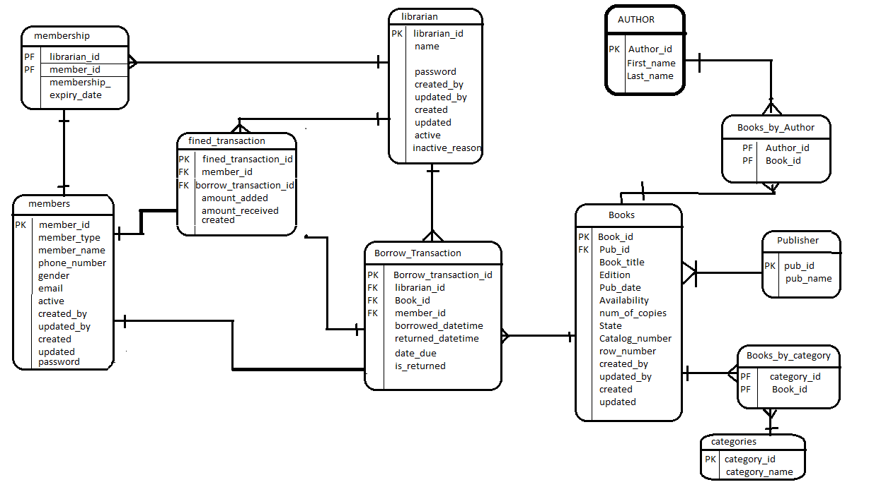
Design and Implementation
Relational Schema (normalized).

Slide 10
Design and Implementation
There are Total 11 tables in this database system
Methods and SQL Queries.
Used nested SQL queries to compute our requirements.
Most of the Computation was mostly done using java

Slide 11
Experimental Results and Discussion
Experimental Set Up (back end platform + GUI).
The setup is so simple and interactive.
The backend coding is done totally in java.
Database is connected using Ojdbc to get the required result of the query .
Evaluation of Queries .
Query is processed in java using Statement and Prepared Statement.
Some Screen Shots are:-

Slide 12
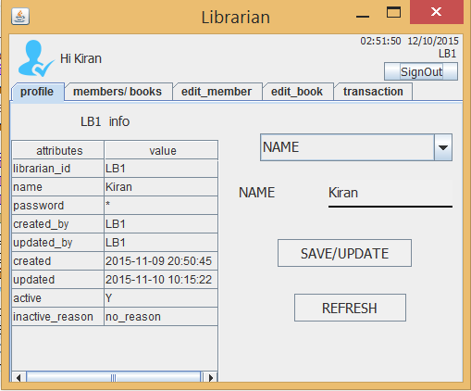
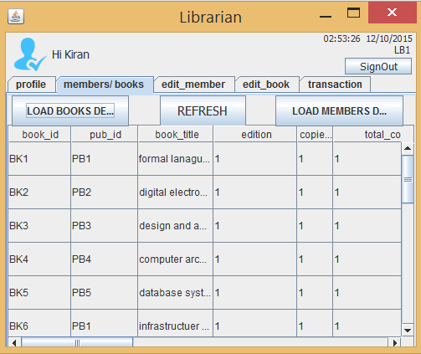
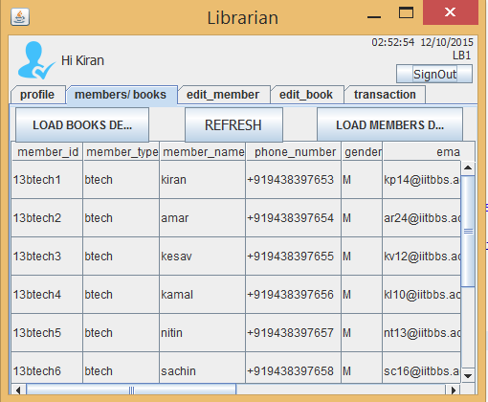
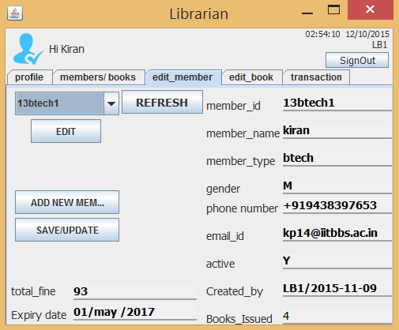
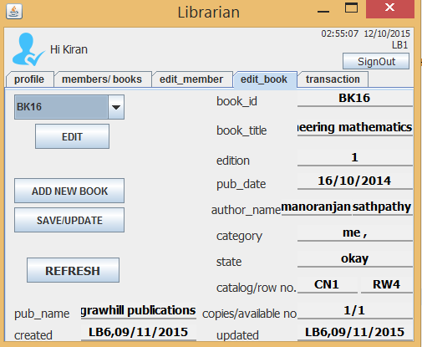
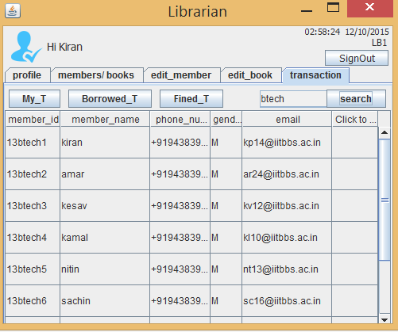
SCREEN SHOTS

Slide 13
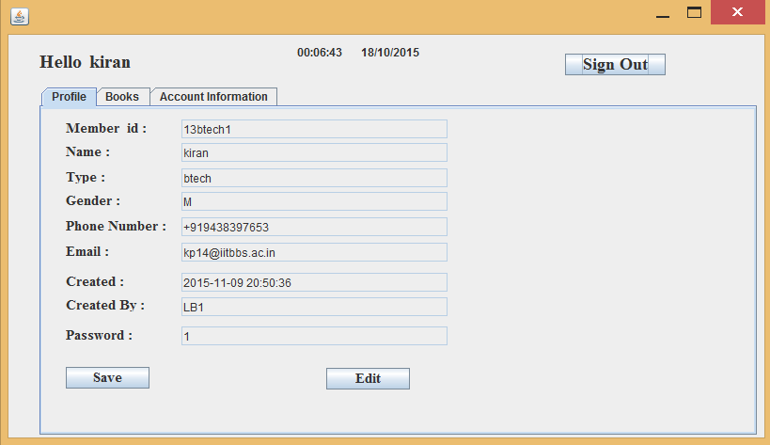
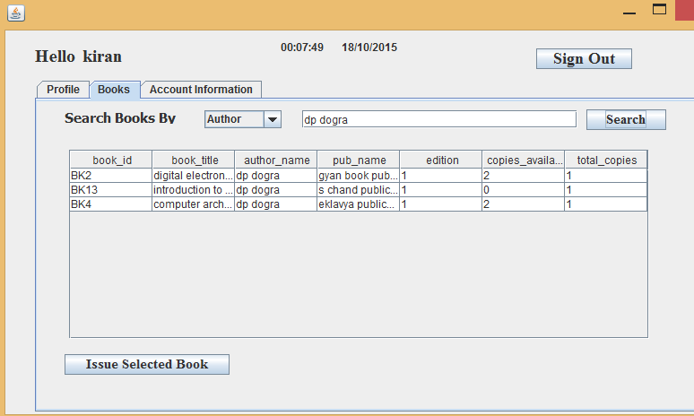
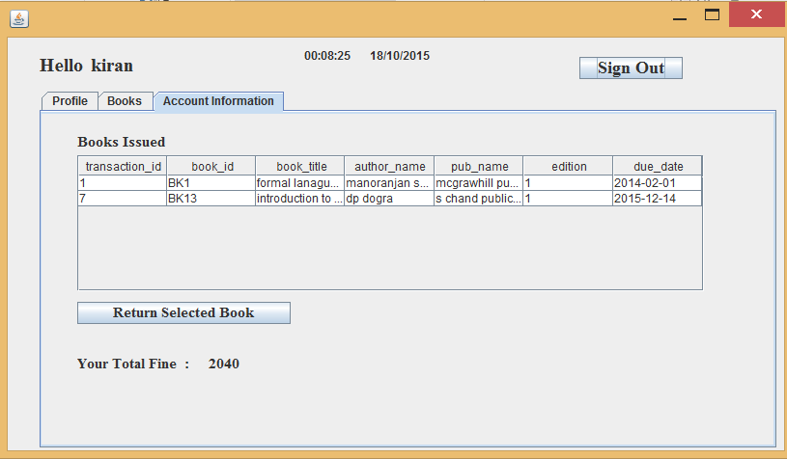
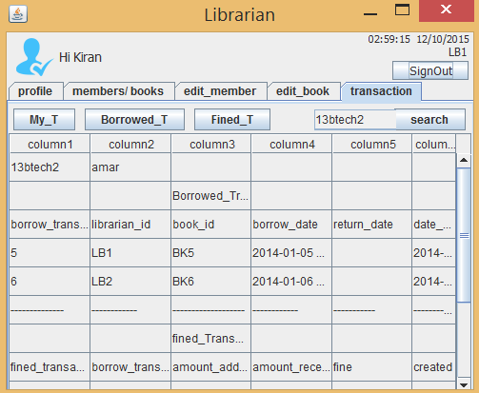
SCREEN
SHOTS

Slide 14
Future Works
Add online eBook system in library
Add Reserve book feature to library

Slide 15
Thanks
Questions & Comments !!

